Slide 1
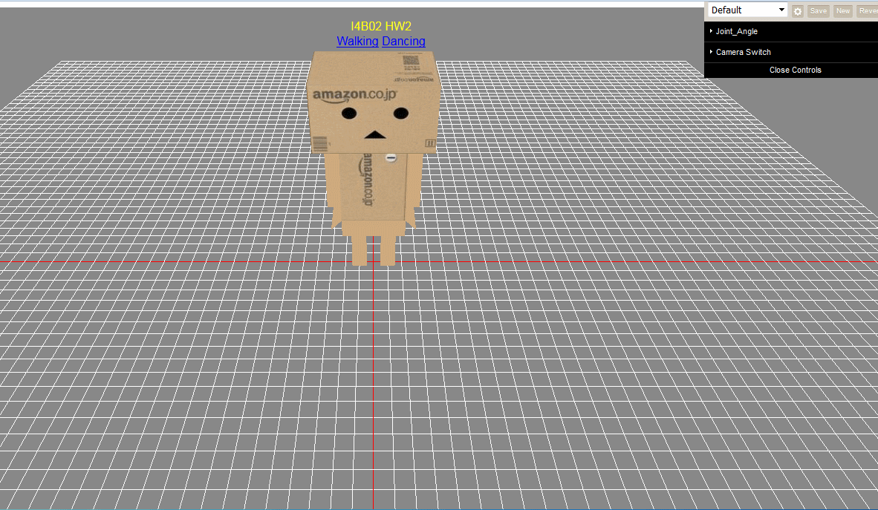
https://jsfiddle.net/je0606ff/149erwmy/

